Slide 1
Model Interpretation
Business Case: Recall vs. Precision
We agreed for our business case, it is crucial to minimize the cases in which we predict no delay, but the flight is actually delayed.
So we need to minimize the false negatives – maximize Recall?
Where do we get the highest percentage?
- Predicting for delays, or for on-time flights ?
Intense Discussion followed:
Predicted:
Yes
Predicted:
No
Actual:
Yes
Actual: No

Slide 2
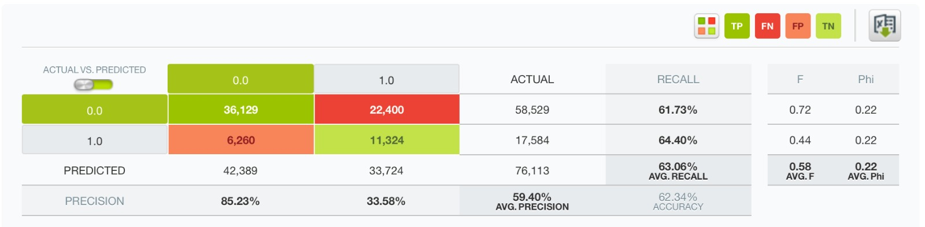

Model Interpretation
Business Case: Recall vs. Precision
What is the optimal metric to for our Business Case
Looking at the confusion matrix of our best model:
Optimal Recall Model
vs.
Optimal Precision Model

Slide 3
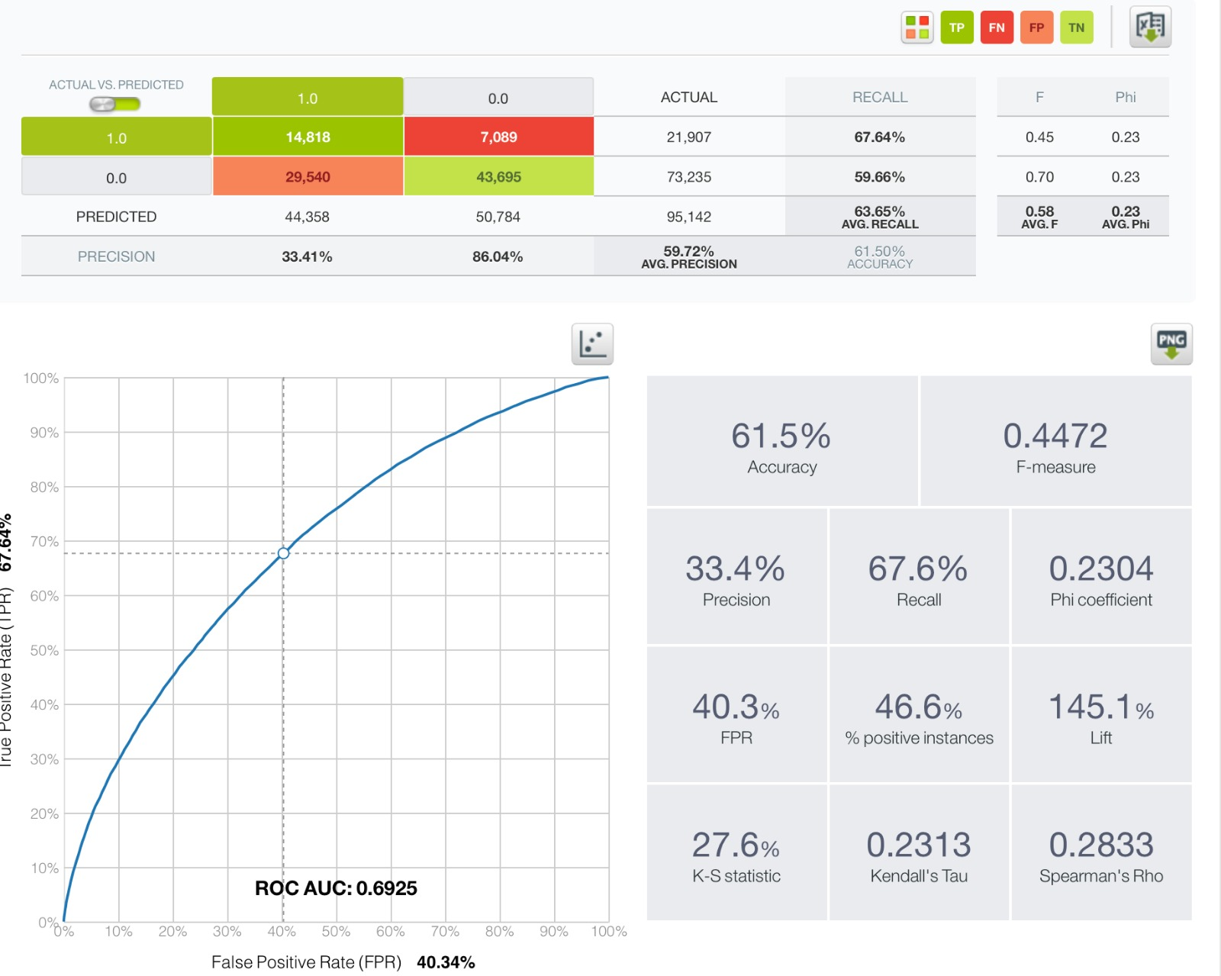
Model Interpretation
Business Case: Recall vs. Precision
What is the optimal metric to for our Business Case
The False Negative we wanted to minimize when predicting for delays, become the false positives when predicting for on-time flights.
The highest percentage we get is for Precision when predicting for flights to be on time.
The False Positives (we predict a flight to be on time, but actually is not) are lower compared to the False Negatives when predicting for delays.
Also, the AUC, which is the most important metric is reasonably high with ca. 70 %
Result: We made a Fusion out of the two model -> Ensemble

Slide 4
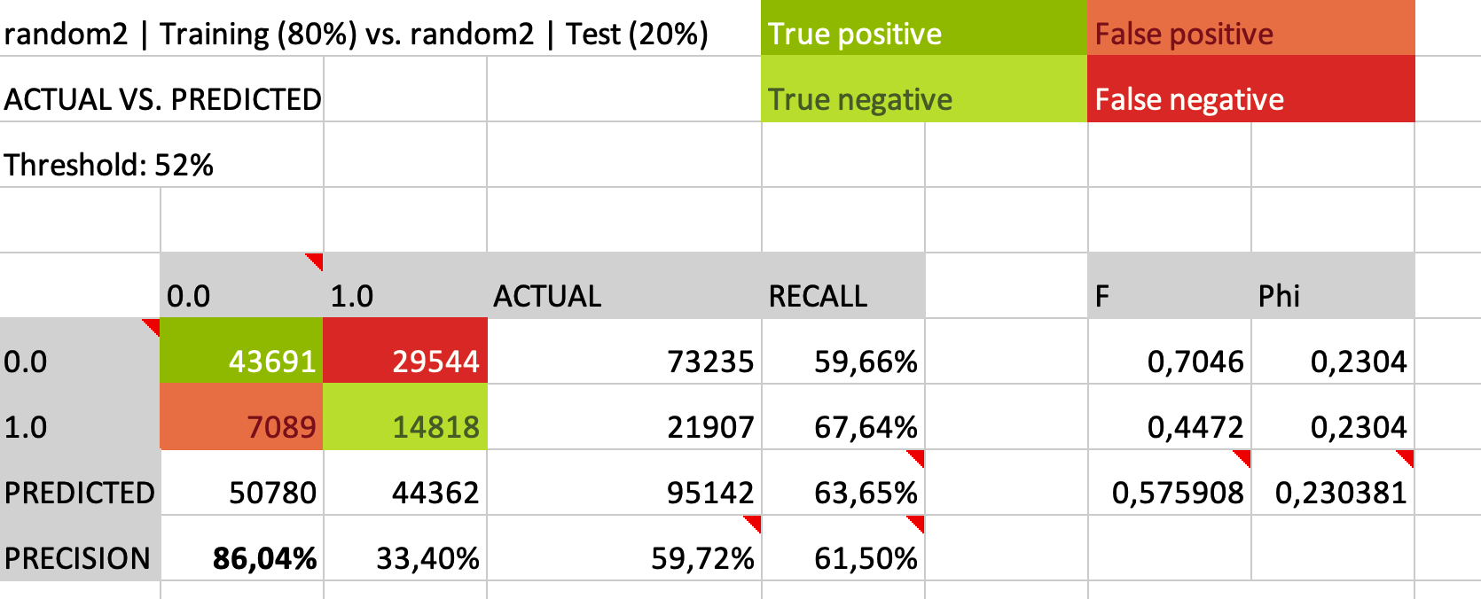
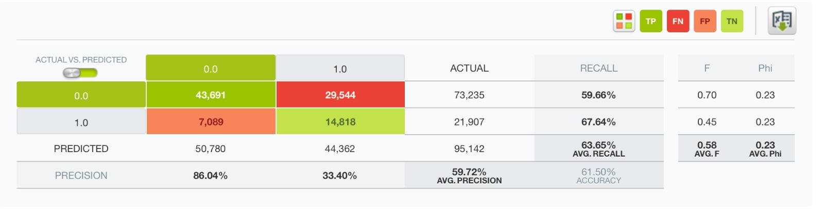
Model Interpretation
Business Case: Recall vs. Precision
What is the optimal metric to for our Business Case
Looking at the confusion matrizes of our best models:
vs.

